Slide 1
Static keyword
static int instances = 0;

Slide 2
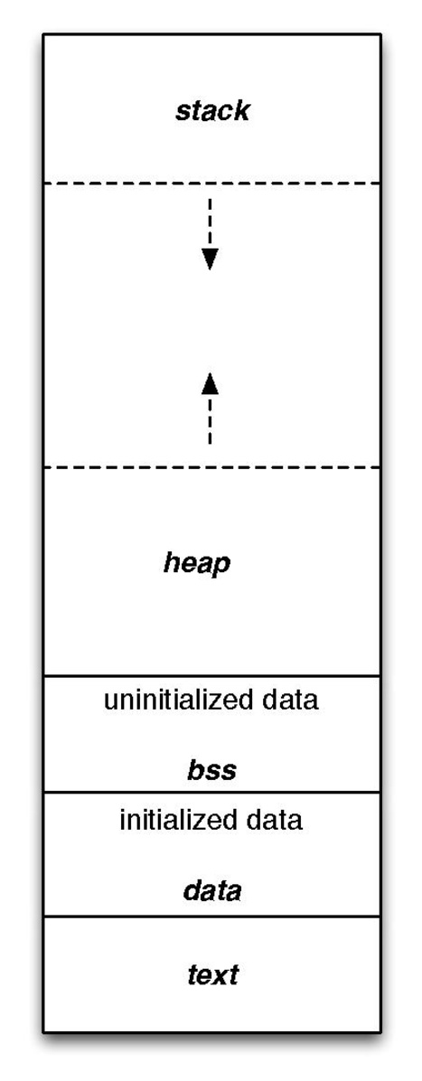
What is a static Variable?
https://en.wikipedia.org/wiki/.bss
A static variable is one that is in memory from program launch to tear down (the program’s lifetime)
It is stored in the BSS segment of your program when uninitialized and DATA when initialized (see left)
It will persistently stay in memory whether you:
Use the function it is defined in
or Use the variable
The scope is unaffected by declaring a variable as static
Note on diagram: At WSU, we will show that the heap and stack at swapped (see diagram on next page)

Slide 3
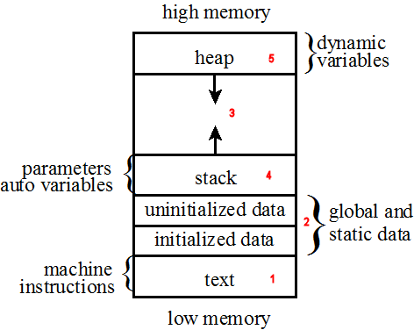
Where are Static Variables Stored?
https://icarus.cs.weber.edu/~dab/cs1410/textbook/4.Pointers/images/layout.png
Dynamic variables are stored in the heap (malloc, calloc)
Stack is where parameters, local vars, and call records are
Uninitialized & initialized are where static and global variables are stored
As we can see, this will not change so we ideally want minimal (if any) global and static data
If you need a global variable, rethink your approach – there is possibly a better way

Slide 4
When Should I use a Static variable?
When we need to
Maintain a variable among multiple instances of a class (C++)
Maintain a value from function call to function call (i.e., strtok)

Slide 5
Pros & Cons
Pros
Allows us to maintain a value in between function calls
Allows us to maintain a count of instances of a specific class
Cons
Becomes non-thread safe
We either need to write a new function or use locks
Uses memory even if we do not touch the function or class (stored in BSS or DATA)
Non-static will grow/shrink based on the usage of functions and classes
Can become more difficult to debug when there are many static vars

Slide 6
Resources to look at for further detail
https://en.wikipedia.org/wiki/Data_segment
https://en.wikipedia.org/wiki/.bss
https://www.gnu.org/software/c-intro-and-ref/manual/html_node/Static-Functions.html

Slide 7
Strtok
#include <string.h> (C)
#include <cstring> (C++)

Slide 8
How to Call strtok
char * input = ”everything is a string”;
char * token;
token = strtok(input, “ “);
printf(“%s\n”, token);
while ((token = strtok(NULL, “ “)) != NULL) {
printf(“%s\n”, token);
}

Slide 9
How to Call strtok (Commented)
char * input = ”everything is a string”; // input
char * token; // where we will store the token
token = strtok(input, “ “); // start strtok (static pointer in strtok is set to input)
printf(“%s\n”, token); // process token
while ((token = strtok(NULL, “ “)) != NULL) { // set to the next token, and run if non-null
printf(“%s\n”, token); // process token
}

Slide 10
Malloc
#include <stdlib.h>

